Slide 1

SQL CASE STUDY
MALDIVES VS LAKSHADWEEP SQL ANALYSIS

Slide 2


Slide 3
TABLES
Destination
TouristAttractions
TouristArrivals
IndianTourists

Slide 4
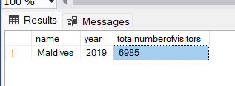
--1)Retrieve the number of visitors to the Maldives in 2019?
select d.[name],ta.[year],sum(ta.NumberofVisitors) as totalnumberofvisitors
from Destination as d
join TouristArrivals ta on d.DestinationID=ta.DestinationID
where [name]='Maldives' and [year]=2019
group by d.[name],ta.[Year];

Slide 5
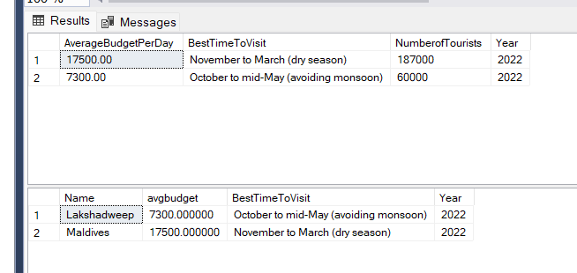
---2)Retrieve the average budget per day and best time to visit for destinations with more than 10,000 tourists in 2022?
select d.AverageBudgetPerDay,d.BestTimeToVisit,IT.NumberofTourists, IT.[Year]
from Destination as d
join IndianTourists as IT on d.DestinationID=IT.DestinationID
where IT.NumberofTourists>=10000 and IT.[Year]=2022;
---or
select d.[Name],AVG( d.AverageBudgetPerDay)as avgbudget,d.BestTimeToVisit,IT.[Year]
from Destination as d
join IndianTourists as IT on d.DestinationID=IT.DestinationID
where IT.NumberofTourists>=10000 and IT.[Year]=2022
GROUP BY IT.[Year],d.BestTimeToVisit,d.[Name];

Slide 6
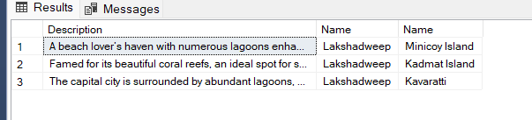
--3)Retrieve the unique features of tourist attractions in Lakshadweep?
select DISTINCT ta.[Description],d.[Name],ta.[Name] from Destination as d
join TouristAttractions as ta on d.DestinationID=ta.DestinationID
where d.[name]='Lakshadweep';

Slide 7
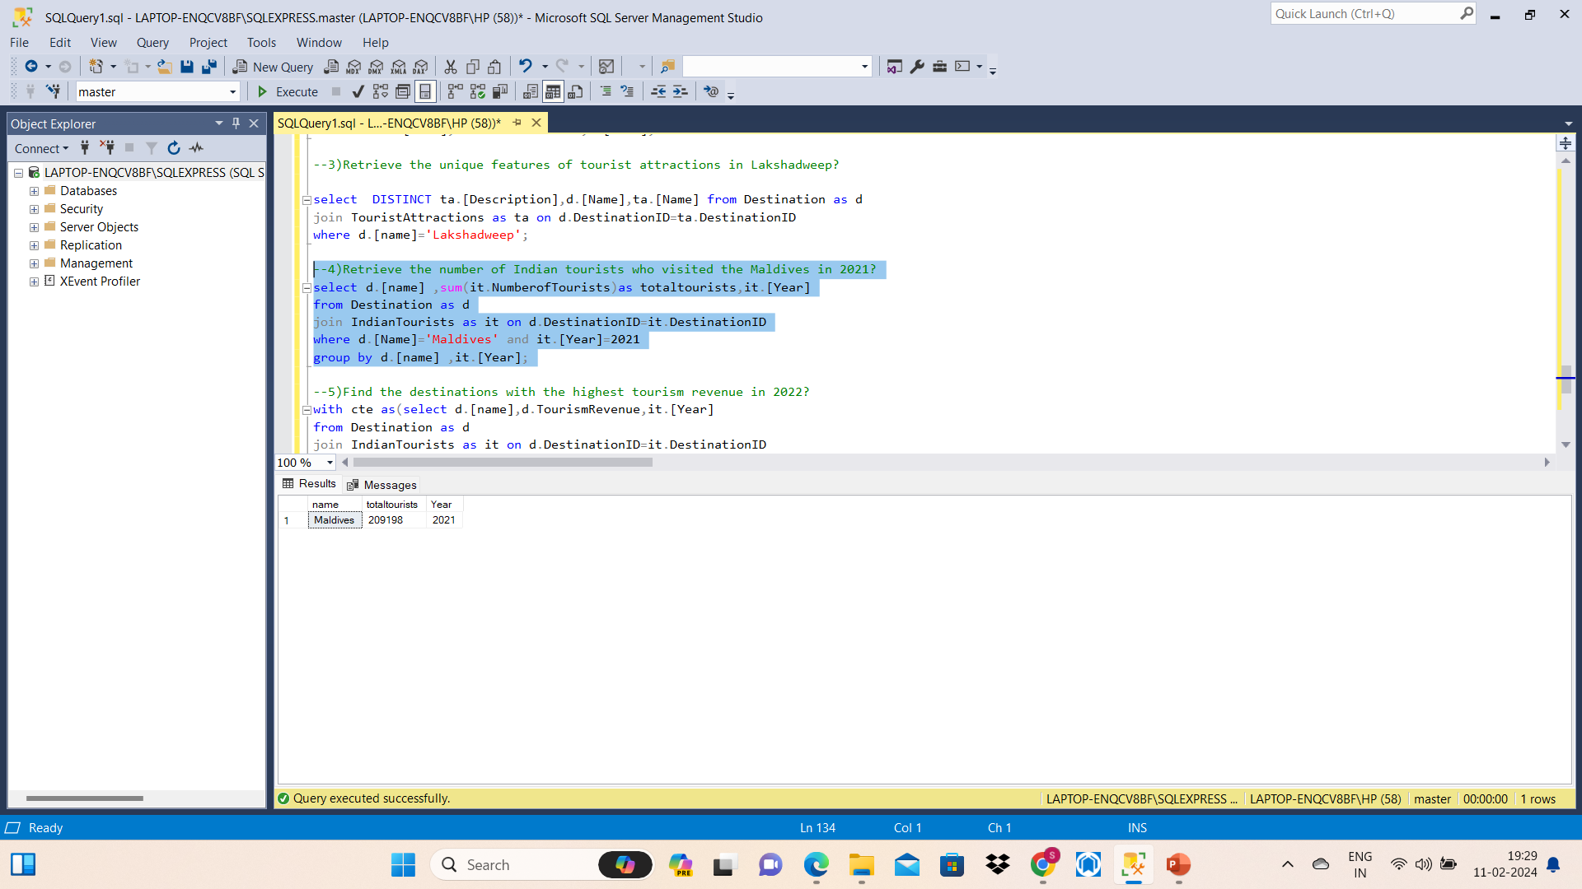
--4)Retrieve the number of Indian tourists who visited the Maldives in 2021?
select d.[name] ,sum(it.NumberofTourists)as totaltourists,it.[Year]
from Destination as d
join IndianTourists as it on d.DestinationID=it.DestinationID
where d.[Name]='Maldives' and it.[Year]=2021
group by d.[name] ,it.[Year];

Slide 8
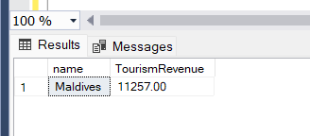
--5)Find the destinations with the highest tourism revenue in 2022?
with cte as(select d.[name],d.TourismRevenue,it.[Year]
from Destination as d
join IndianTourists as it on d.DestinationID=it.DestinationID
where it.[Year]=2022)
select name,TourismRevenue from cte
where TourismRevenue=(select max(TourismRevenue) from cte)

Slide 9
Thank you

